Slide 1
ORM – Object Relational Mapping
Presented by: Rishikesh Khodke
Authored by: Rishikesh Khodke

Slide 2
Course Structure
Target audience | Open for All
Level | Level 1
Pre-requisites | Basic knowledge of any programming language such as c or c++.
Training methods | PPT and Interaction with audience.
Evaluation | After completion of Training program,.

Slide 3
ORM – Object Relational Mapping
Copyright © 2019 Cybage Software Pvt. Ltd. All Rights Reserved. Cybage Confidential.
www.cybage.com

Slide 4
Agenda
What Is OOP, Classes, Methods and Objects?
What Is DBMS and RDBMS?
What Is ORM?
Why ORM?
Use Of ORM
Pros & Cons Of ORM
Well-known ORM’s For PHP

Slide 5
What is OOP….
Object-oriented programming (OOP) is a programming language model organized around objects rather than "actions" and “data” rather than “logic”.
Data and Functions can be represented as re-usable objects, thus cutting down code and time.

Slide 6
Class, Methods and Object ….
Class is the blueprint for your object.
This is a programmer-defined data type, which includes local functions as well as local data.
You can think of a class as a template for making many instances of the same kind (or class) of object.
The class contains Methods and Properties
Characteristic's of the object
These are the function defined inside a class and are used to access object data.
Object is a bunch of variables and functions all lumped into a single entity.
An individual instance of the data structure defined by a class

Slide 7
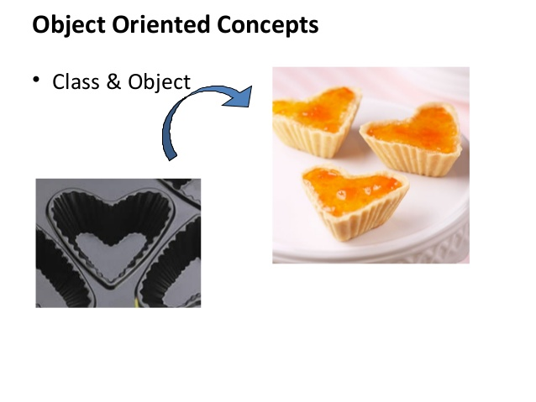
Class & Yummy Object ☺

Slide 8
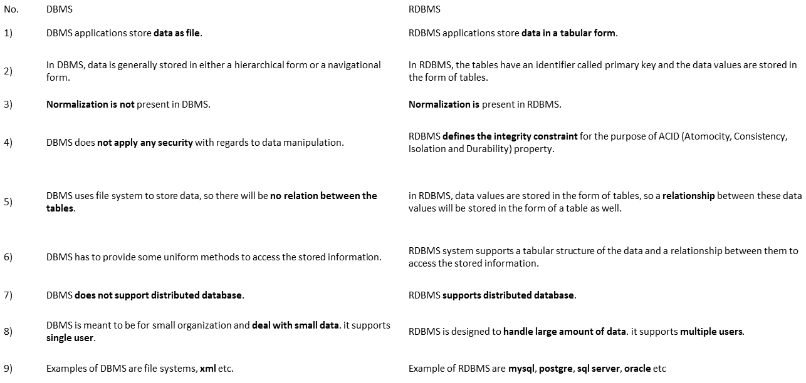
DBMS and RDBMS ….

Slide 9
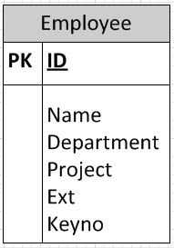
How we store Data in DB? Table Structure….

Slide 10
How we store Data in DB? Code….
<?php
//Connect to the Database
mysql_connect ("host_name_or_IP_Address","username","password") or die ('Cannot connect to MySQL: ' . mysql_error());
mysql_select_db ("database_name") or die ('Cannot connect to the database: ' . mysql_error());
$query = mysql_query(“insert into employee values (‘29’, ’Dev’, ’Engineering’, ’45’)”);

Slide 11
What is ORM….
Wikipedia Definition : Programming technique for converting data between incompatible type systems in relational databases and object-oriented programming languages.
Simple: Map class properties with DB fields and provide methods to manipulate data.
In a nutshell, an ORM framework is written in an object oriented language (like PHP, Java, C# etc…) and it is designed to virtually wrap around a relational database.
This basically translates into: mapping objects to relational tables.

Slide 12
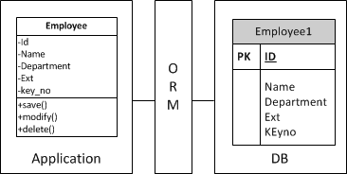
What is ORM – Diagram….

Slide 13
Types/Patterns….
Table Data Gateway
Active Record

Slide 14
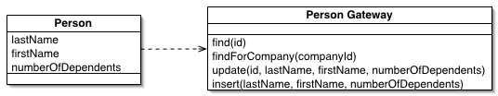
Table Data Gateway -One as to One….
An object that acts as a Gateway to a database table.
One instance handles all the rows in the table.
$user = new User;
$user->username = ‘PHPStars’;
EntityManager::persist($user);

Slide 15
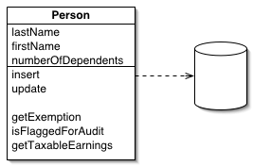
Active Record: Wrap around One Row….
An object that wraps a row in a database table or view, encapsulates the database access, and adds domain logic on that data.
$user = new User;
$user->username = ‘PHPStars';
$user->save();

Slide 16
What ORM do….
ORM framework/software generates objects (as in OOP) that virtually map the tables in a database.
Programmer, would use these objects to interact with the database.
Main idea, is to try and shield the programmer from having to write optimized SQL code – the ORM generated objects take care of that for you.

Slide 17
Pros….
Harmonization of data types between the OO language (in our case, PHP) and the SQL database.
Simpler for developers ,clean and maintainable code.
Supports many database platforms.
Supports many different languages.
The impedance mismatch is handled for us.
Developer can focus on the code, not the database.
ORM frameworks will shield your application from SQL injection attack.

Slide 18
Cons….
Can be cumbersome to set up at the start.
Joins and complex queries can be difficult to fit into framework.
Hard to read performance metrics –SQL Plan.
ORM frameworks can’t do it all
Allows you to write straight SQL if need be.
Another layer between the database and the application.

Slide 19
Well-Known ORM’s for PHP….
Doctrine
DQL (Doctrine Query Language)
Part of Zend Framework : Zend Db
CakePHP has ORM built into it.
RedBean ORM without configuration!

Slide 20
Example : core php
$book_list = new List();
$sql = "SELECT * FROM books WHERE author = 'Peter'";
$result = mysql_query($sql); // I over simplify ...
while ($row = mysql_fetch_assoc($result)) {
$book = new Book();
$book.setAuthor($row.get('author');
$book_list.add($book);
}

Slide 21
Example : using ORM
$book_list = Book.query(author="Peter");

Slide 22
Example : using ORM
$client = new client; $client->name = 'John Doe'; $client->address = 'Av. Somewhere Over The Rainbow, 555'; $client->save();

Slide 23
Example : using ORM
$client = new client('John Doe'); $client->name = 'John Done'; $client->save();

Slide 24
Example : using ORM
$client = new client('John Doe'); $client->name = 'John Done'; $client->delete();
Notes:
https://codereview.stackexchange.com/questions/169345/building-a-simple-orm-in-php

Slide 25


Copyright © 2019 Cybage Software Pvt. Ltd. All Rights Reserved. Cybage Confidential.
www.cybage.com

Slide 26

Thank You!
5/10/2019
www.cybage.com
Copyright © 2019 Cybage Software Pvt. Ltd. All Rights Reserved. Cybage Confidential.

